Slide 1



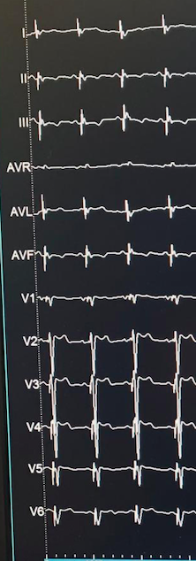
RS (183MS) BIV (171MS) BIV-LOT (126MS)
ECG FINAL

Slide 2
